Slide 1
Membership Inference Attacks
against
Machine Learning Models
Team: 丁丁汪汪叫

Slide 2
Reference Paper
Membership Inference Attacks Against Machine Learning Models (2017 IEEE Symposium on Security and Privacy)
Machine Learning with Membership Privacy using Adversarial Regularization (2018 ACM SIGSAC)
Deep Learning with Differential Privacy (2016 ACM CCS)
ML-Leaks: Model and Data Independent Membership Inference Attacks and Defenses on Machine Learning Models

Slide 3
Outline
Membership inference attack
Our experiments
Defense
Future work

Slide 4
Problem Statement
A machine learning algorithm is used to train a classification model that captures the relationship between the content of the data records and their labels.
For any input data record, the model outputs the prediction vector of probabilities, one per class, that the record belongs to a certain class.
We will also refer to these probabilities as confidence values. The class with the highest confidence value is selected as the predicted label for the data record.

Slide 5
Membership Inference Attack
The attacker has query access to the model and can obtain the model’s prediction vector on any data record.
The attacker is given a data record and black-box query access to the target model. The attack succeeds if the attacker can correctly determine whether this data record was part of the model’s training dataset or not.

Slide 6
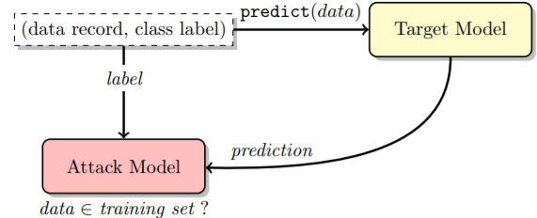

Slide 7
Attack Flow

Slide 8
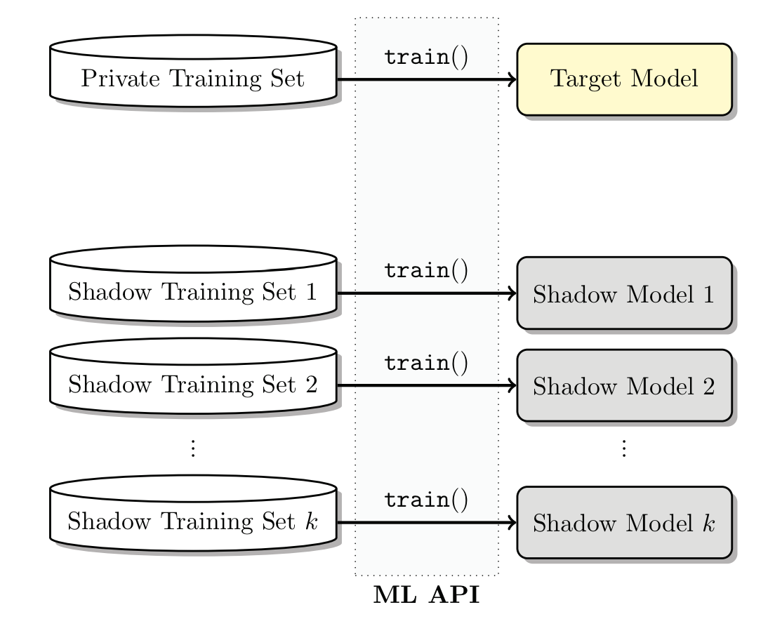
Shadow Models

Slide 9
Generating Training Data for Shadow Models
Model-based synthesis: Data classified with high confidence should be similar to target’s training dataset.
Statistics-based synthesis: Generate data from known distribution.
Noisy real data: Use data that is similar to target’s training dataset. (Considered as a noisy version.)

Slide 10
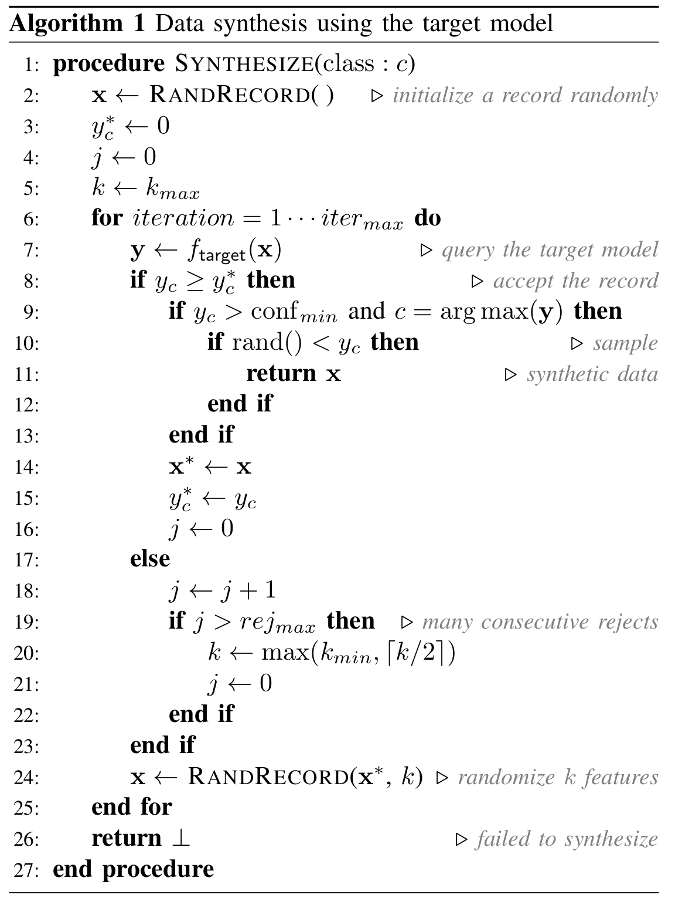
Model-based Synthesis

Slide 11
Train shadow models
Shadow training data
(Label = ‘in’)
NN
Probabilities
Inference
Shadow testing data
(Label = ‘out’)

Slide 12
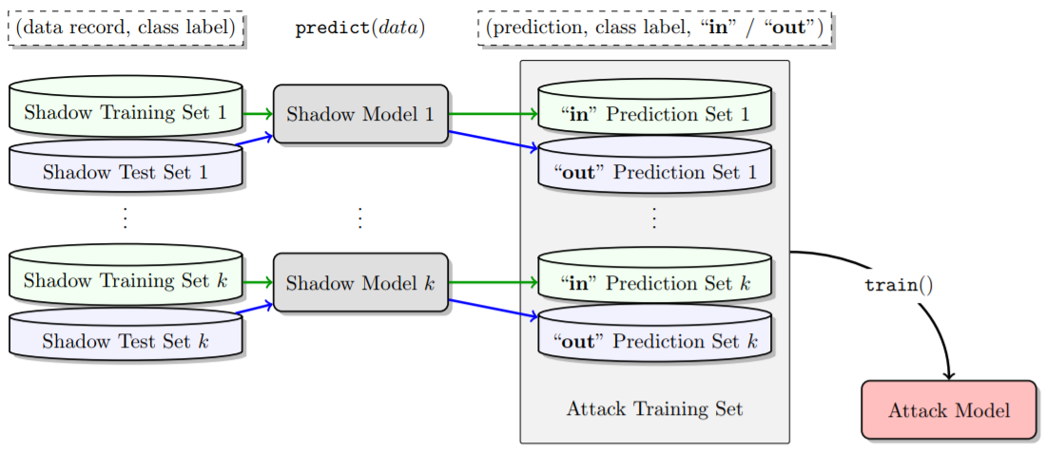

Slide 13
Train attack model
The attack model learns the correlation between probabilities and whether the data is from the training set.
Shadow probabilities
NN
IN or OUT

Slide 14
Experiments

Slide 15
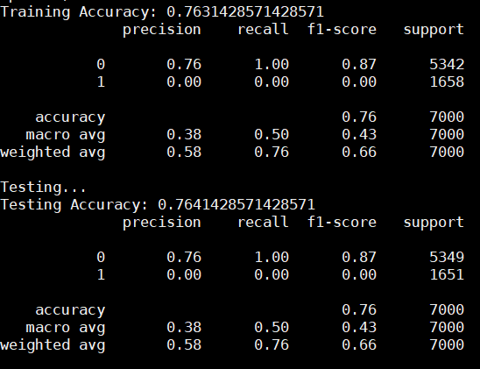
Results - UCI Adult (Census Income)
32000 samples
Features: gender, occupation, nationality, age, working hours…
Predict whether a person earns more than $50K or not.

Slide 16
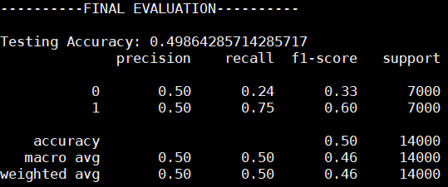
Results - UCI Adult (Census Income)
Does not overfit.
Only two classes -> Too coarse grained. Might not be enough for the model to learn the difference of probability between two classes.

Slide 17
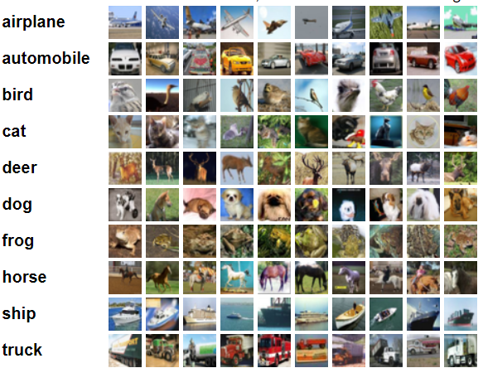
Result: CIFAR-10

Slide 18
Result: CIFAR-10
60,000 records.
10,000 records for target model training.
10 shadow models.
For each shadow models, sample 10,000 records from the rest 50,000 samples for training, 10,000 for testing.
Fit the shadow models to 0.55~0.6 validation accuracy.
Use SVM to train attack model.

Slide 19
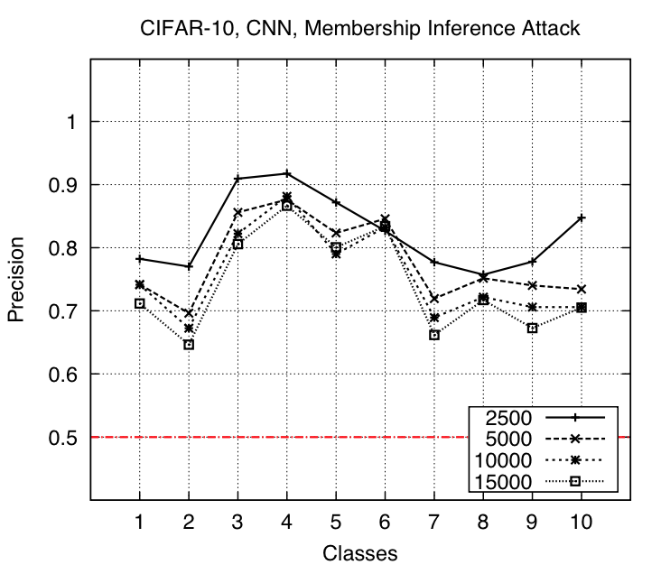
Result: CIFAR-10
Dataset size | Precision | Recall | Accuracy
2500 | 0.77 | 1.0 | 0.84
5000 | 0.73 | 1.0 | 0.81
10000 | 0.73 | 1.0 | 0.81
15000 | 0.69 | 1.0 | 0.79

Slide 20
Result: UCI Adult
Features: gender, occupation, nationality, age, working hours…
Predict whether a person earns more than $50K or not.
The model is a binary classifier. This is not enough for our attack to extract useful membership information from the model.
Accuracy | Precision | Recall | F1 score
0.498 | 0.5 | 0.5 | 0.46

Slide 21
Result: MNIST
Accuracy: ~0.5
The lack of randomness in the training data for each class and the small number of classes contribute to the failure of the attack.

Slide 22
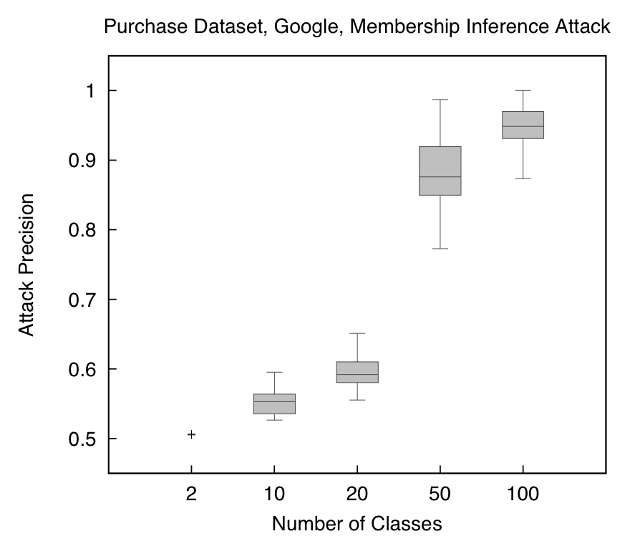
Result: Google platform

Slide 23
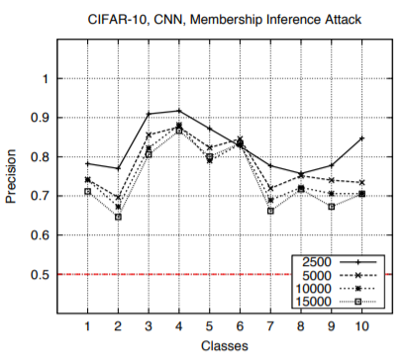
Result - CIFAR-10
Not done yet.... But I can show you some results from the paper.
Testing accuracy: 0.6
-> Overfit
Large gaps between training and test accuracy indicate overfitting. Larger test accuracy indicates better generalizability and higher predictive power.

Slide 24
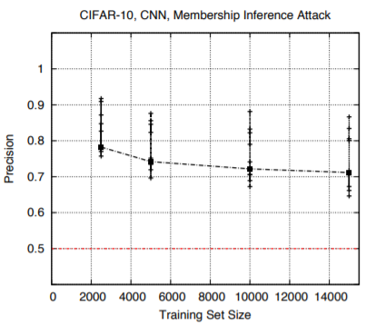
Result - CIFAR-10
Not done yet.... But I can show you some results from the paper.
Testing accuracy: 0.6
-> Overfit
Large gaps between training and test accuracy indicate overfitting. Larger test accuracy indicates better generalizability and higher predictive power.

Slide 25
Defense
Mitigation techniques: Limit model’s predictions : reducing the precision of predictions Model regularization : prevent overfitting
Differential privacy mechanisms
Adversarial Regularization Machine Learning with Membership Privacy using Adversarial Regularization
Dropout, model stacking ML-Leaks: Model and Data Independent Membership Inference Attacks and Defenses on Machine Learning Models

Slide 26
Result: CIFAR-10
Add L2 regularization
Dataset size | Precision | Recall | Accuracy
2500 | 0.78 | 0.18 | 0.57
5000 | 0.61 | 0.06 | 0.52
15000 | 0.40 | 0.0008 | 0.50

Slide 27
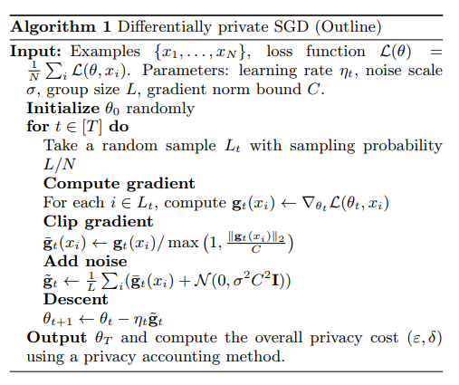
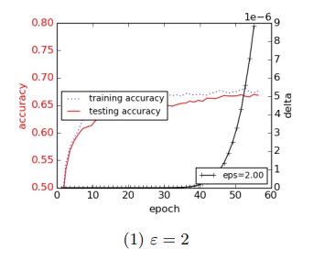
Differentially private SGD

Slide 28
Adversarial Regularization
MIN-MAX MEMBERSHIP PRIVACY GAME
minimizes privacy loss (adversary’s maximum gain)
minimizes classification loss
Advantage
Reduce classification accuracy drop
Automatically improve defense ability through training

Slide 29
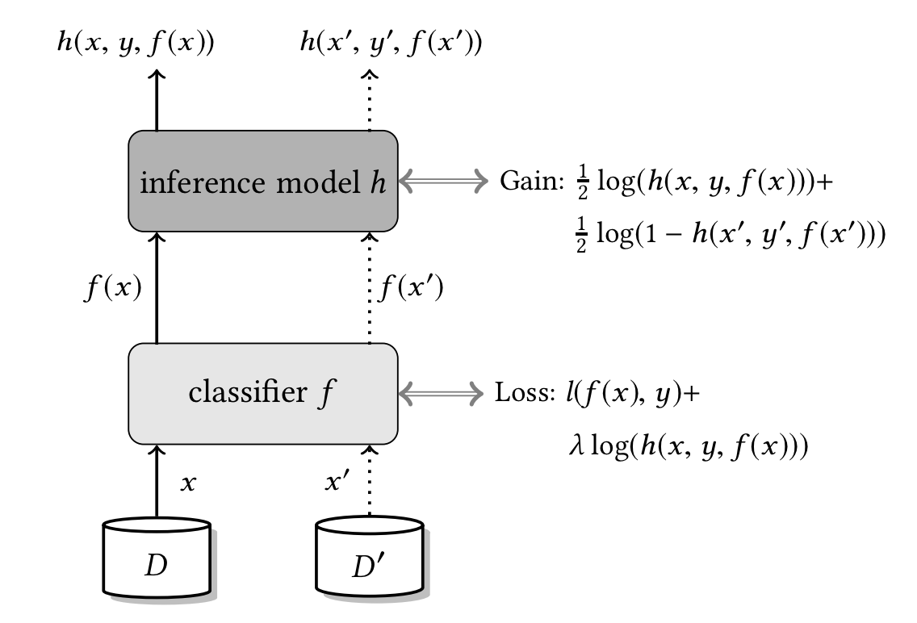
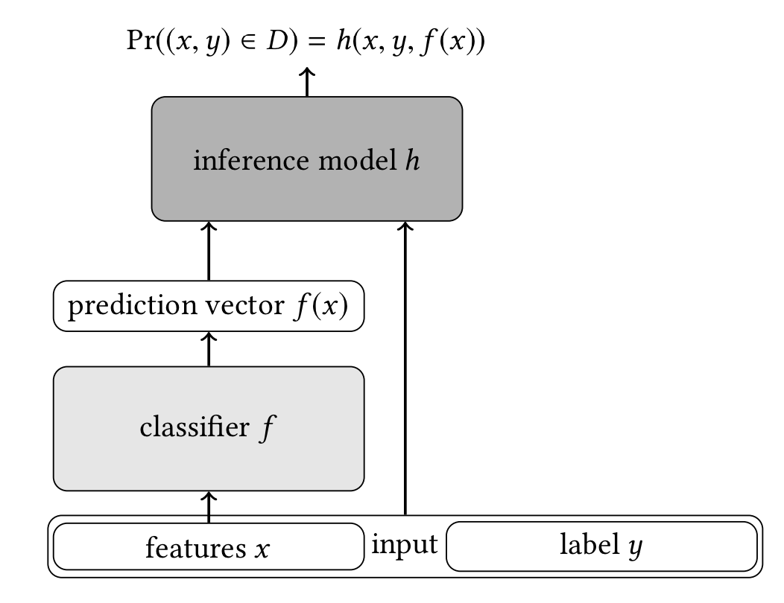
Adversarial Regularization

Slide 30
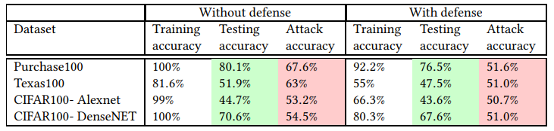
Results

Slide 31
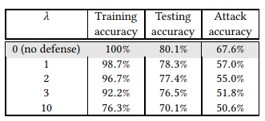
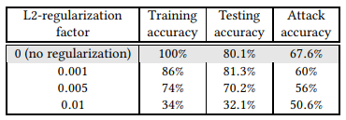
Comparison

Slide 32
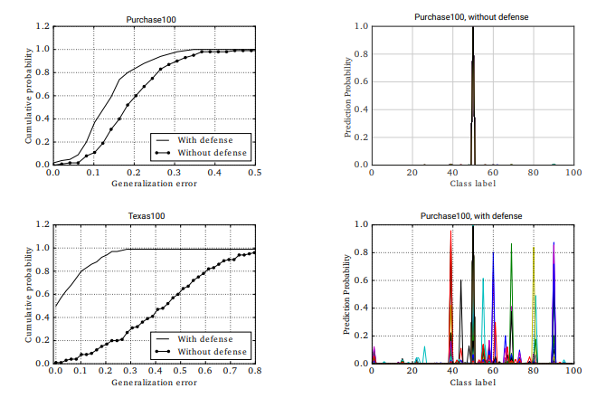
Visualization

Slide 33
Limitation
Much longer training time
Defend are limited to specific attack
Adversarial training are not very stable

Slide 34
Future Work
Does the attack model REALLY learn something?
ML-Leaks: Model and Data Independent Membership Inference Attacks and Defenses on Machine Learning Models - Adversary 1: Use only one shadow model - Adversary 2: Data transfer attack - Adversary 3: Use only posteriors: Maximum, Entropy, STD

Slide 35
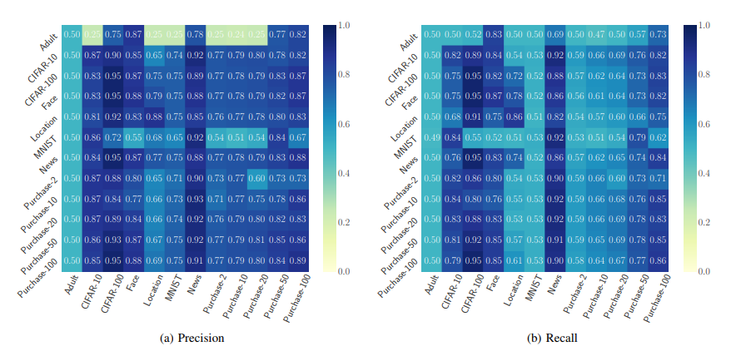

Slide 36
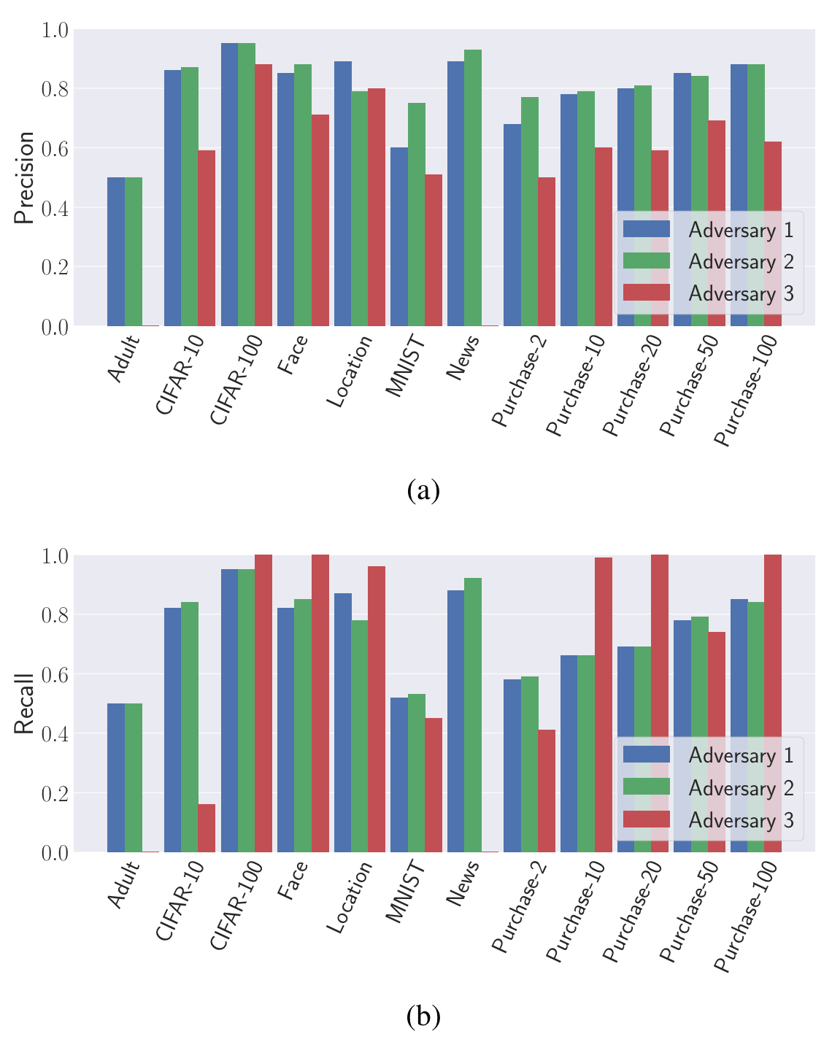

Slide 37
Thank you

